Slide 1

The HPV Vaccine - Why It’s Important
Notes:
[Sources]
- Background image derived from the user-provided ACCF PowerPoint deck uploaded in this conversation.

Slide 2
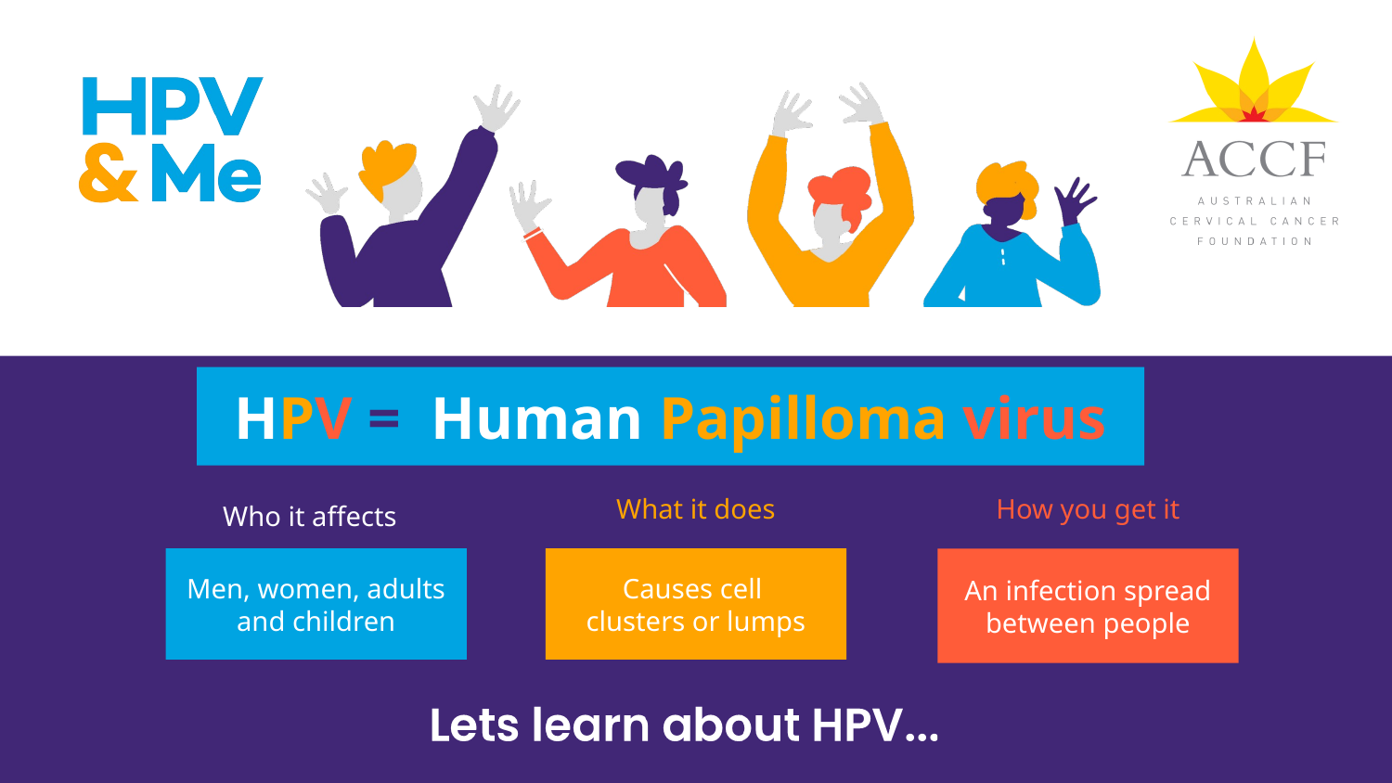
Notes:
[Sources]
- Background image derived from the user-provided ACCF PowerPoint deck uploaded in this conversation.

Slide 3
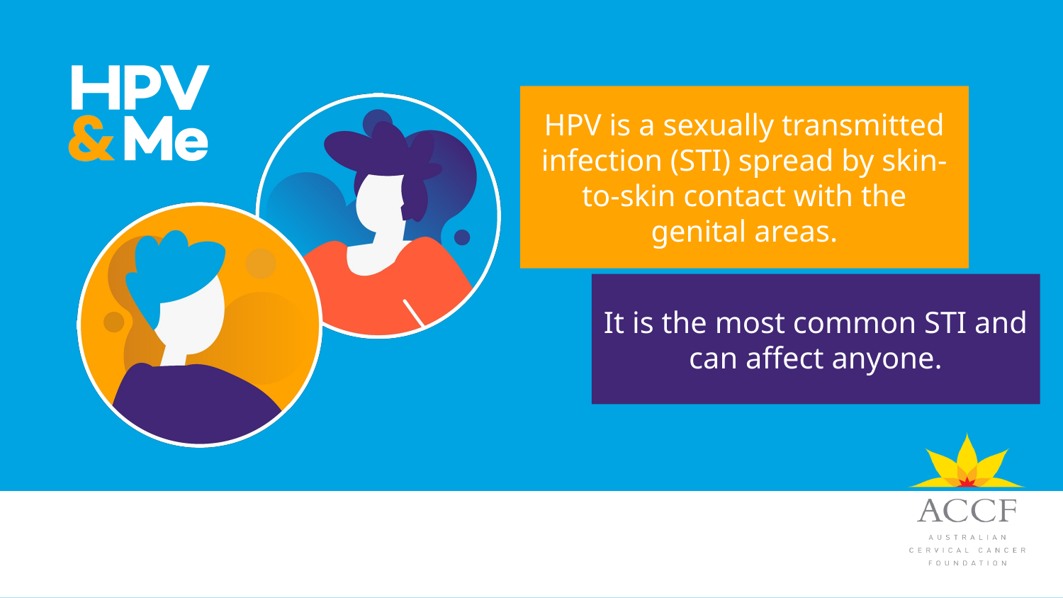
Notes:
[Sources]
- Background image derived from the user-provided ACCF PowerPoint deck uploaded in this conversation.

Slide 4
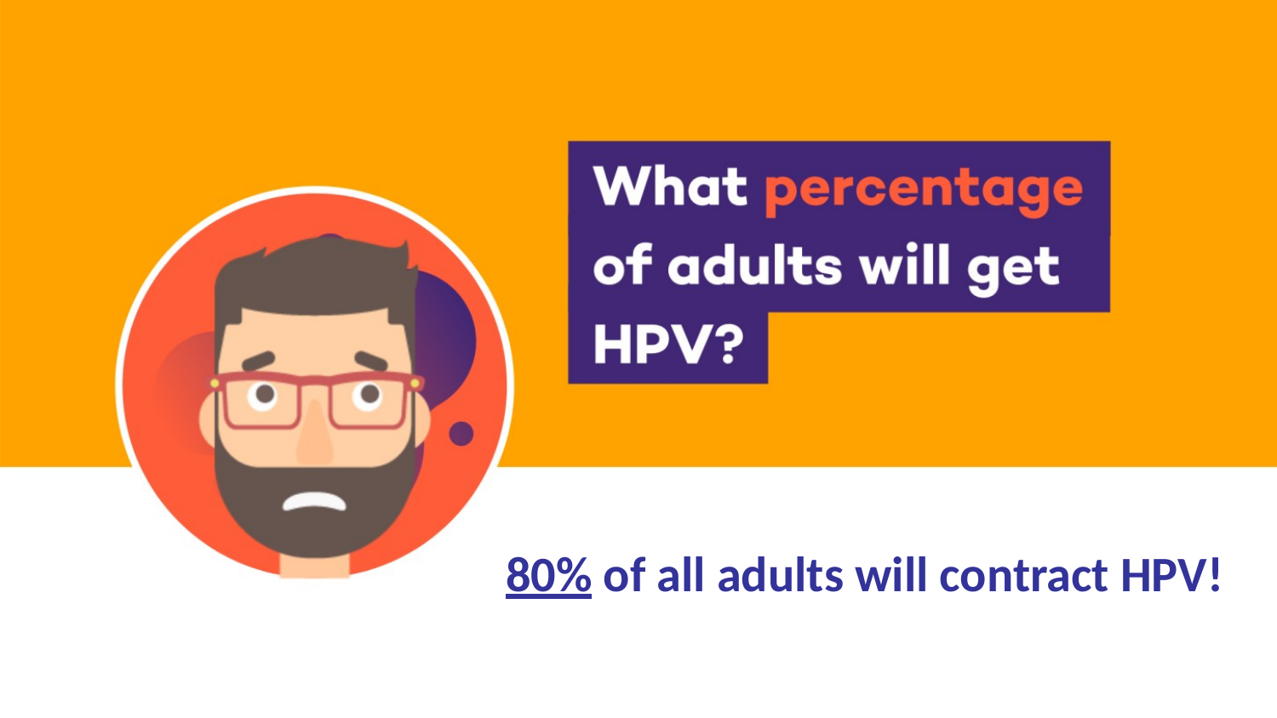
Can you guess what percentage of adults would get an HPV infection in their lifetime before a vaccine was available?
Take your best guess.
20%
50%
80%
100%
Notes:
[Sources]
- Background image derived from the user-provided ACCF PowerPoint deck uploaded in this conversation.

Slide 5
Can you guess what percentage of adults would get an HPV infection in their lifetime before a vaccine was available?
80%! HPV was very common, but prevention still matters today.
Continue
Notes:
[Sources]
- Background image derived from the user-provided ACCF PowerPoint deck uploaded in this conversation.

Slide 6
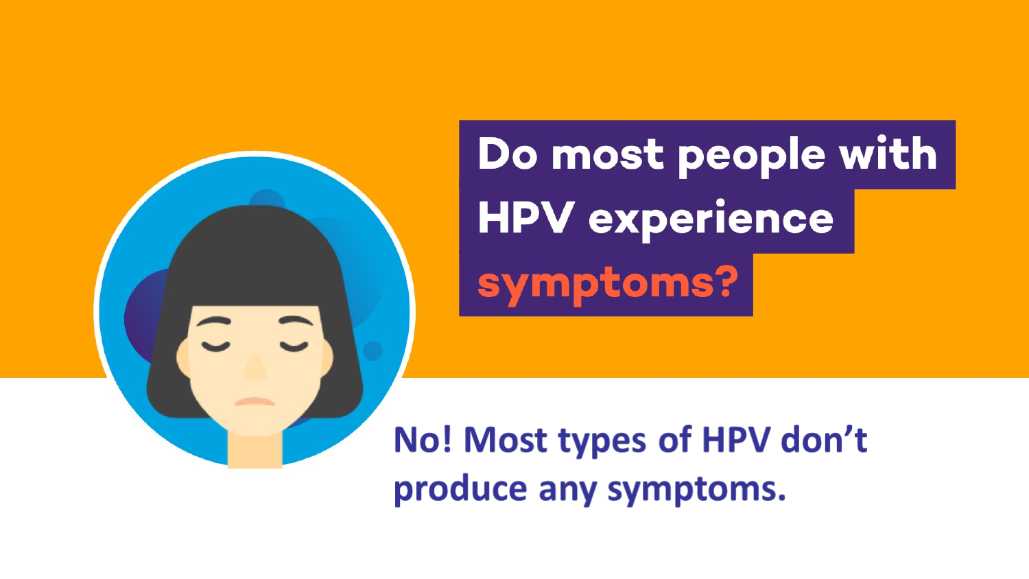
Yes or No?
Yes
No
Notes:
[Sources]
- Background image derived from the user-provided ACCF PowerPoint deck uploaded in this conversation.

Slide 7
No, most people with HPV do not have symptoms, so they may not know they have it.
Notes:
[Sources]
- Background image derived from the user-provided ACCF PowerPoint deck uploaded in this conversation.

Slide 8
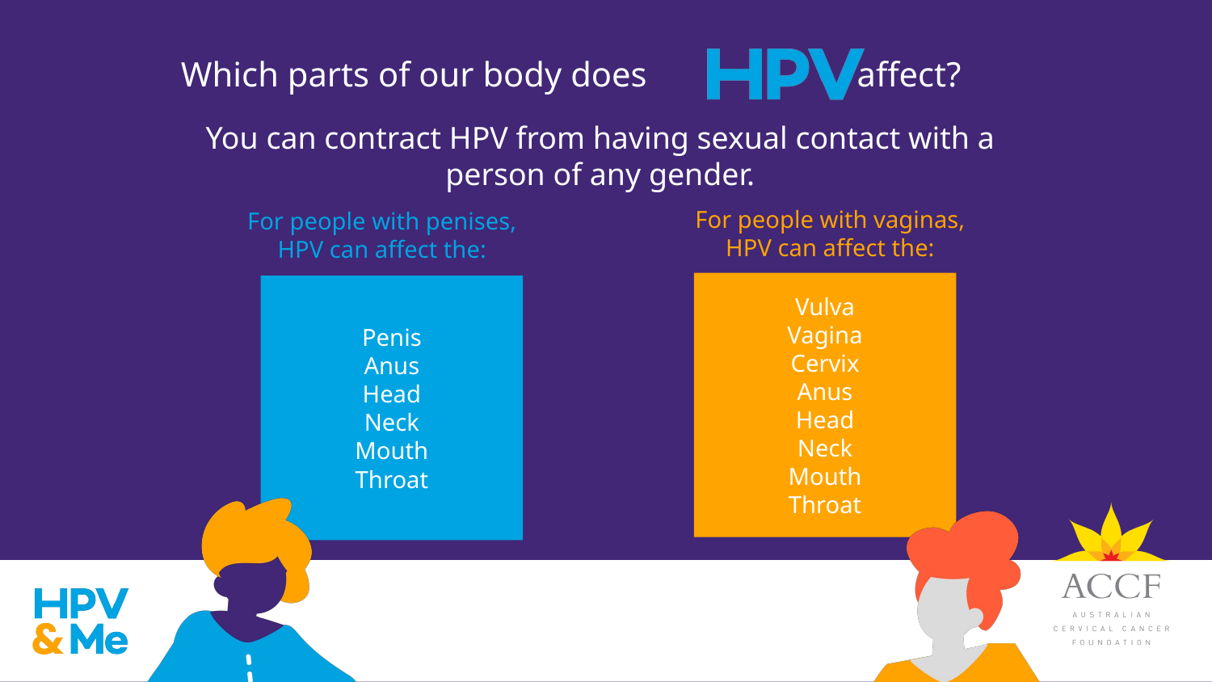
Notes:
[Sources]
- Background image derived from the user-provided ACCF PowerPoint deck uploaded in this conversation.

Slide 9
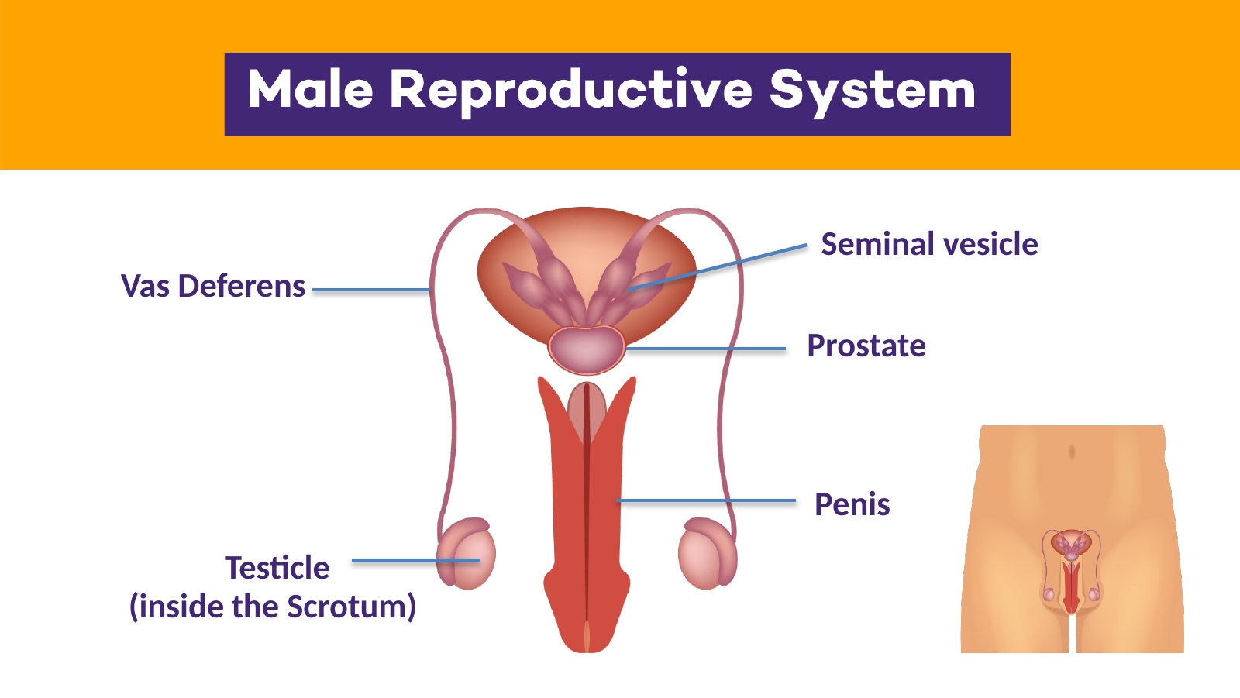
Apart from the penis and testicles, have you heard of these other body parts?
Notes:
[Sources]
- Background image derived from the user-provided ACCF PowerPoint deck uploaded in this conversation.

Slide 10
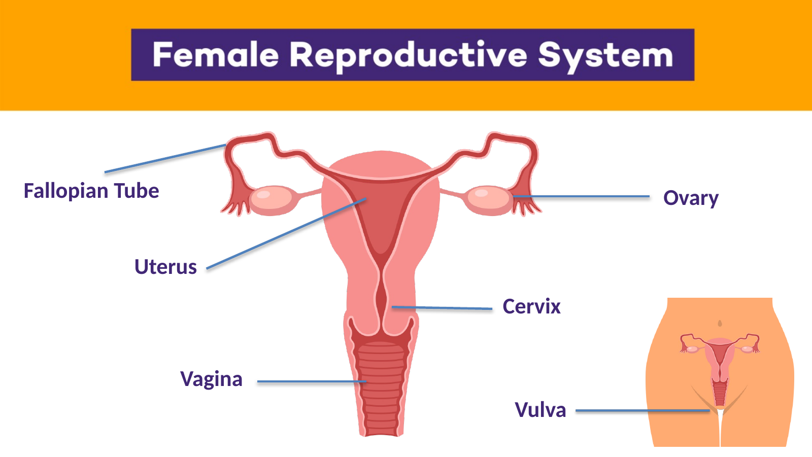
Have you heard of the cervix, do you know why its important with respect to the
HPV virus?
.
Continue
Notes:
[Sources]
- Background image derived from the user-provided ACCF PowerPoint deck uploaded in this conversation.

Slide 11
It’s important because HPV can cause cancer of the cervix (or cervical cancer).
.
Notes:
[Sources]
- Background image derived from the user-provided ACCF PowerPoint deck uploaded in this conversation.

Slide 12
Remember this list of body parts that the HPV virus can affect?
Continue
Notes:
[Sources]
- Background image derived from the user-provided ACCF PowerPoint deck uploaded in this conversation.

Slide 13
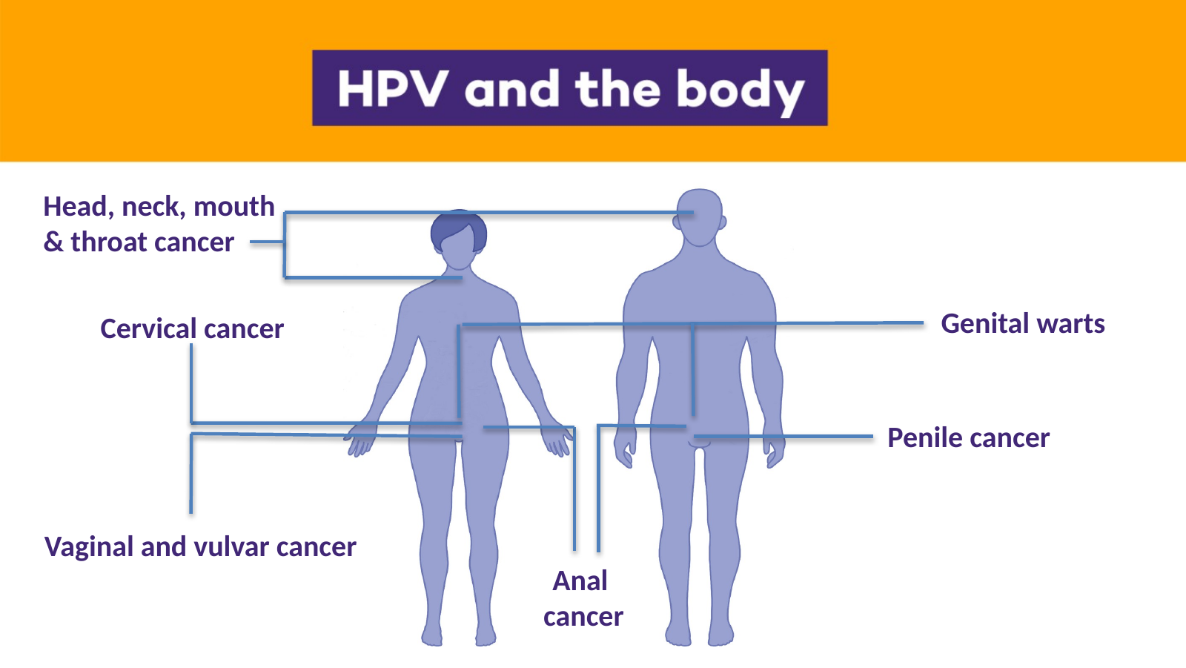
The HPV virus can cause all these cancers,
and genital warts
Genital warts are small lumps that are caused by infections which are not cancerous.
Vaginal and Vulva cancer
Notes:
[Sources]
- Background image derived from the user-provided ACCF PowerPoint deck uploaded in this conversation.

Slide 14
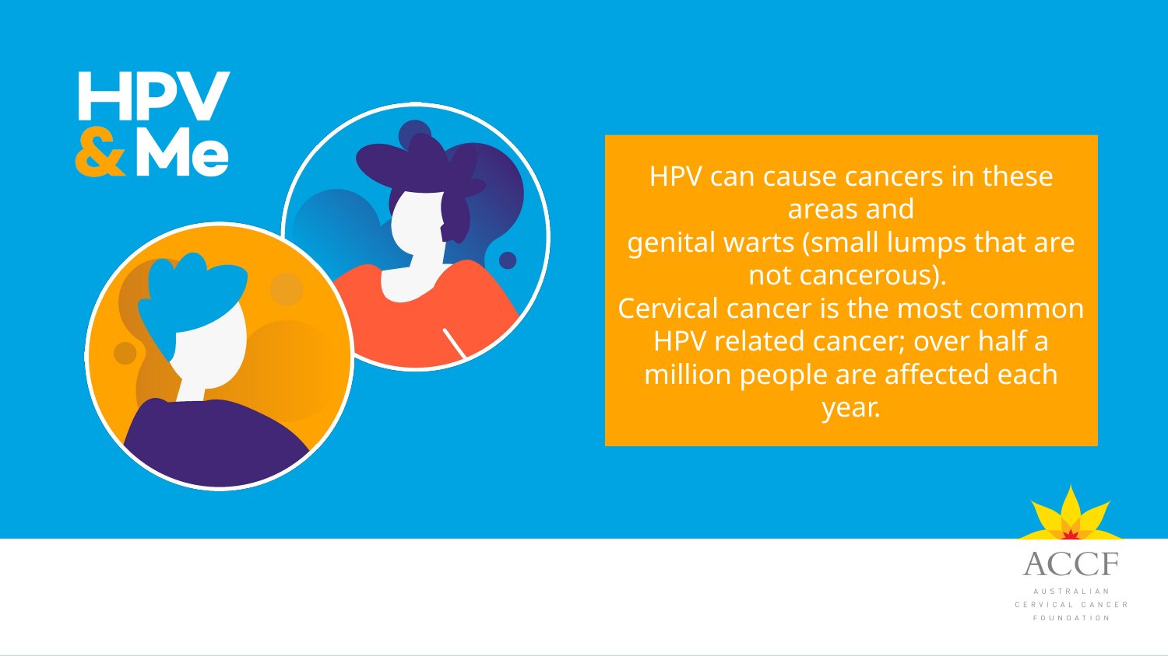
Why are we working hard to prevent cervical cancer?
Notes:
[Sources]
- Background image derived from the user-provided ACCF PowerPoint deck uploaded in this conversation.

Slide 15
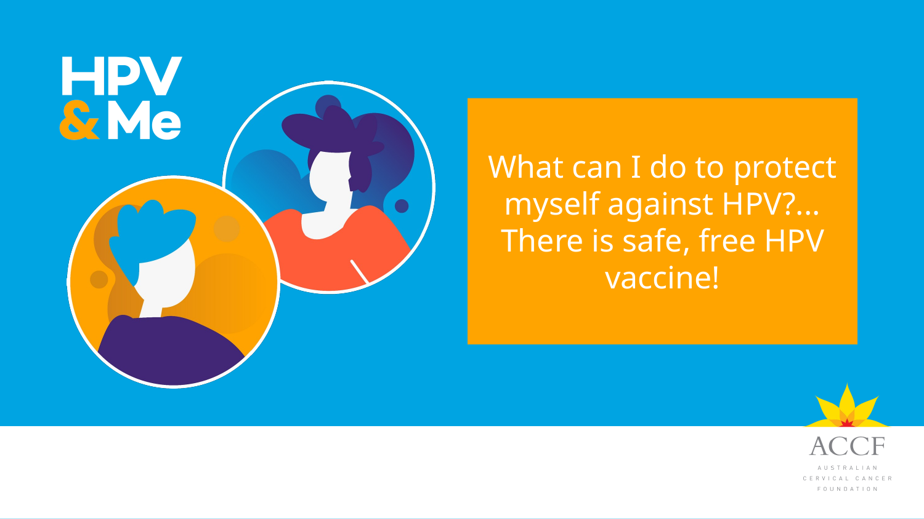
Notes:
[Sources]
- Background image derived from the user-provided ACCF PowerPoint deck uploaded in this conversation.

Slide 16
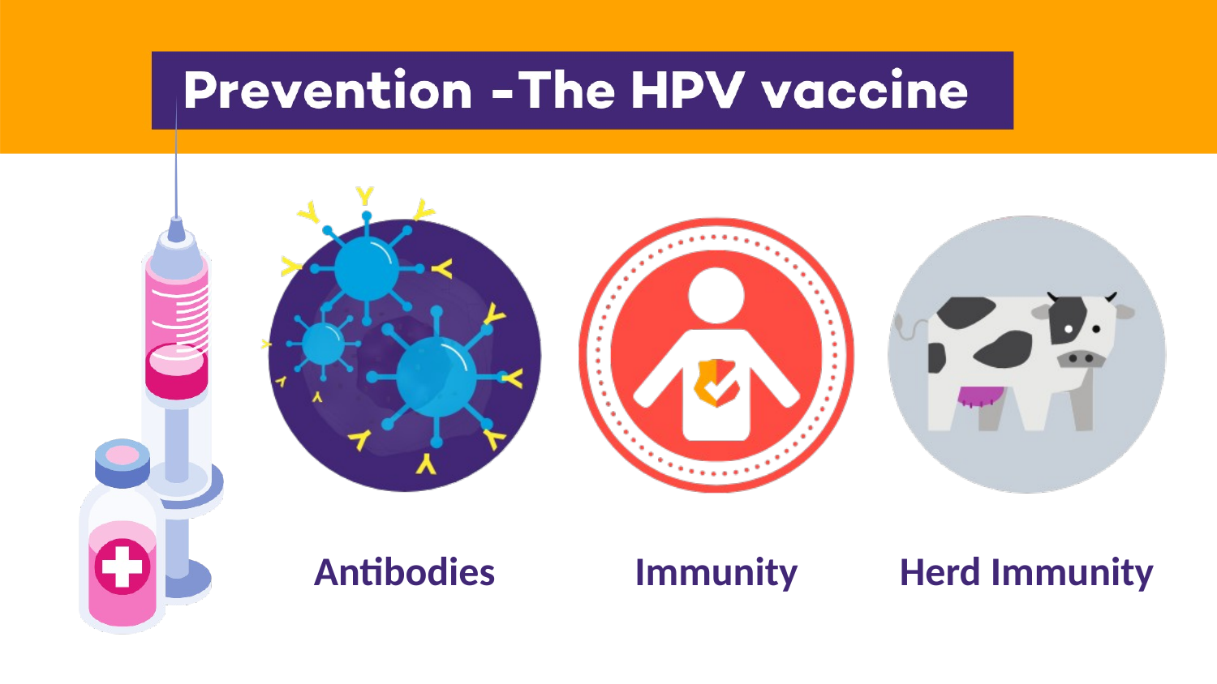
What do vaccines help our bodies make?
Antibodies?
Bones?
Muscles?
Notes:
[Sources]
- Background image derived from the user-provided ACCF PowerPoint deck uploaded in this conversation.

Slide 17
Antibodies - Vaccination helps us build immunity and herd immunity.
Back
Notes:
[Sources]
- Background image derived from the user-provided ACCF PowerPoint deck uploaded in this conversation.

Slide 18
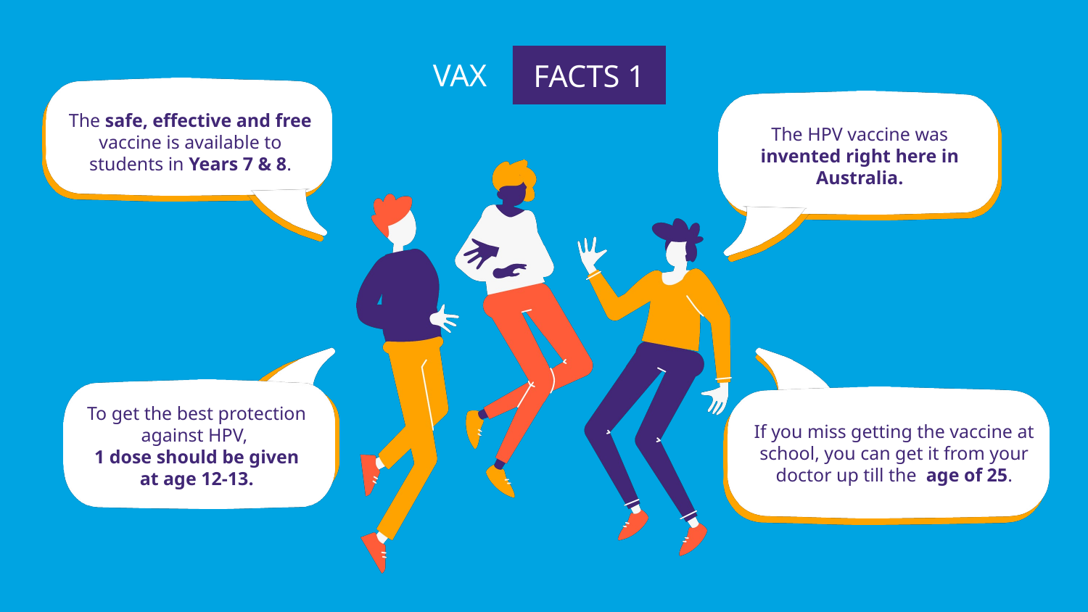
Notes:
[Sources]
- Background image derived from the user-provided ACCF PowerPoint deck uploaded in this conversation.

Slide 19
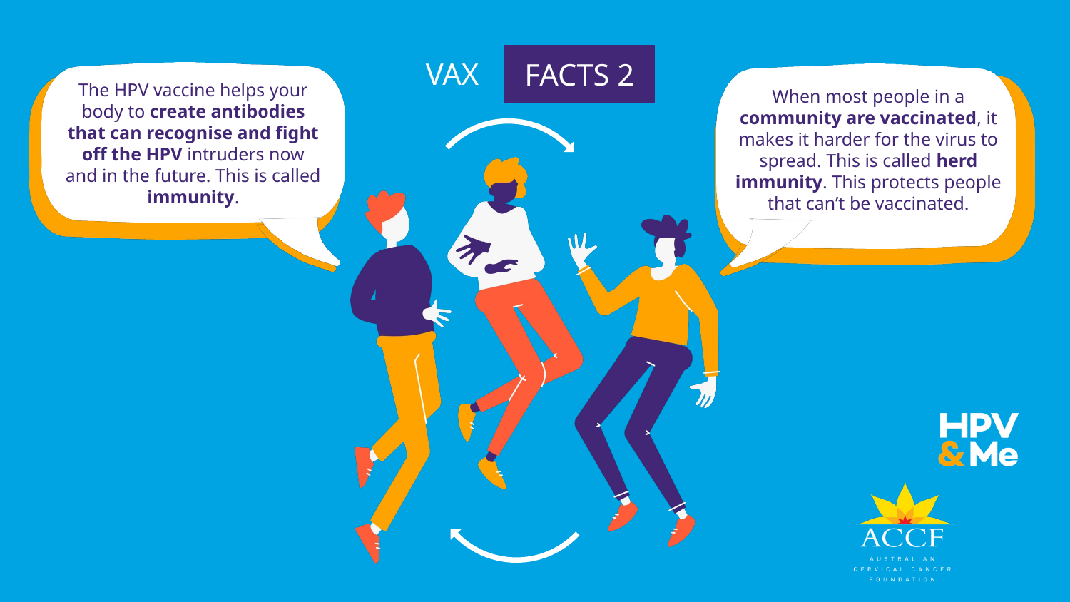
Notes:
[Sources]
- Background image derived from the user-provided ACCF PowerPoint deck uploaded in this conversation.

Slide 20
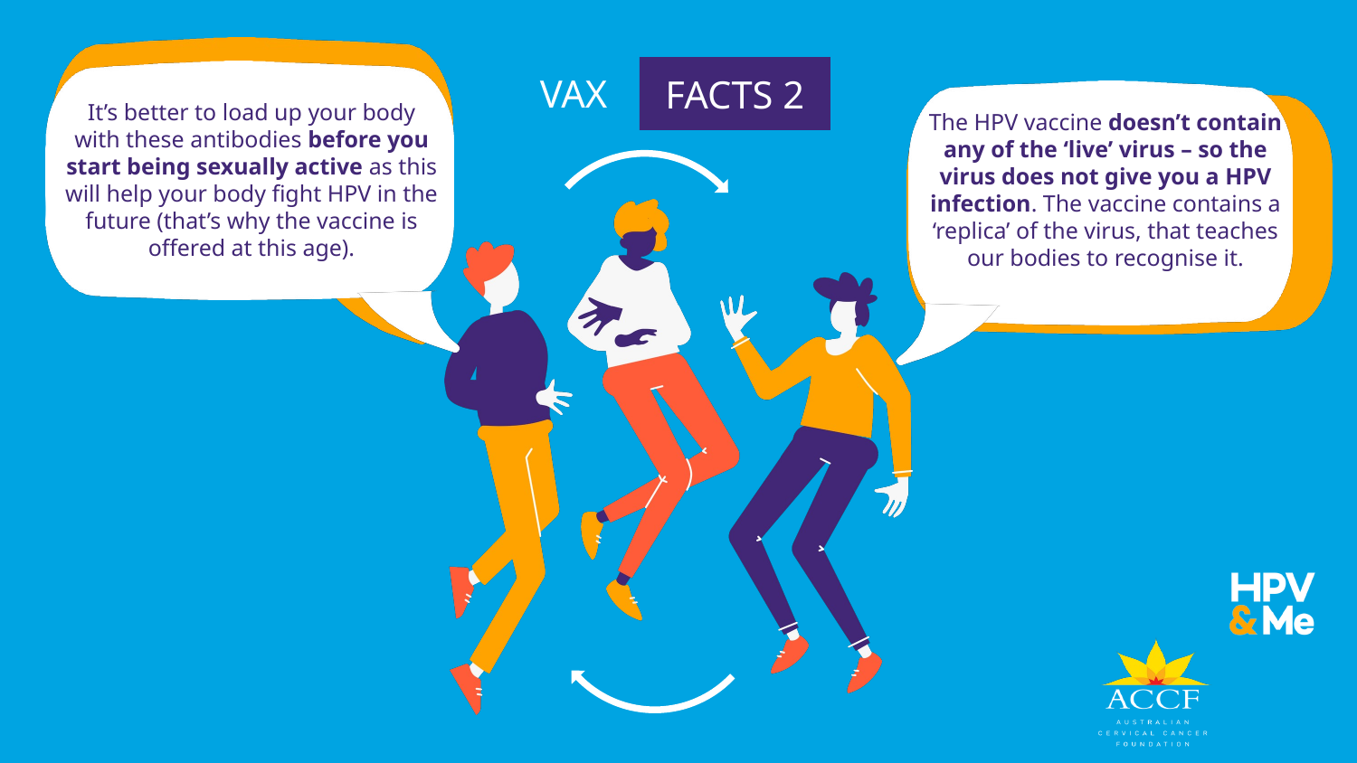
FACTS 3
The HPV vaccine doesn’t contain any of the ‘live’ virus – so the vaccine cannot cause an HPV infection. The vaccine contains a replica of the virus that teaches our bodies to recognise the virus and fight it.
Notes:
[Sources]
- Background image derived from the user-provided ACCF PowerPoint deck uploaded in this conversation.

Slide 21
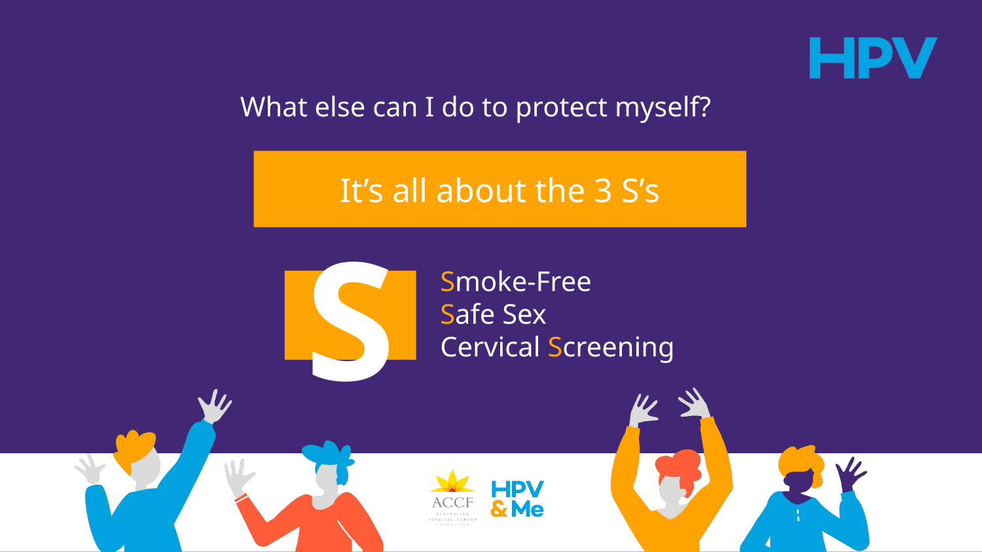
These prevention steps work best together with vaccination.
Notes:
[Sources]
- Background image derived from the user-provided ACCF PowerPoint deck uploaded in this conversation.

Slide 22
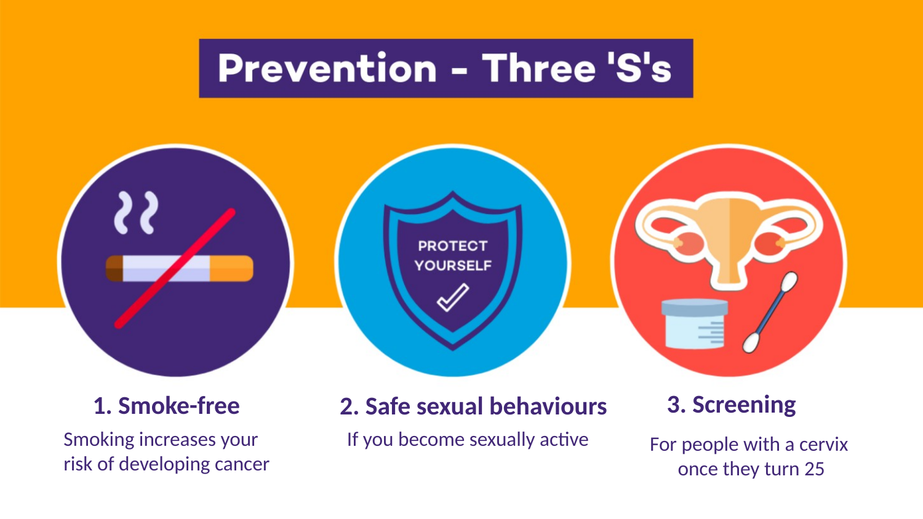
Continue
Notes:
[Sources]
- Background image derived from the user-provided ACCF PowerPoint deck uploaded in this conversation.

Slide 23
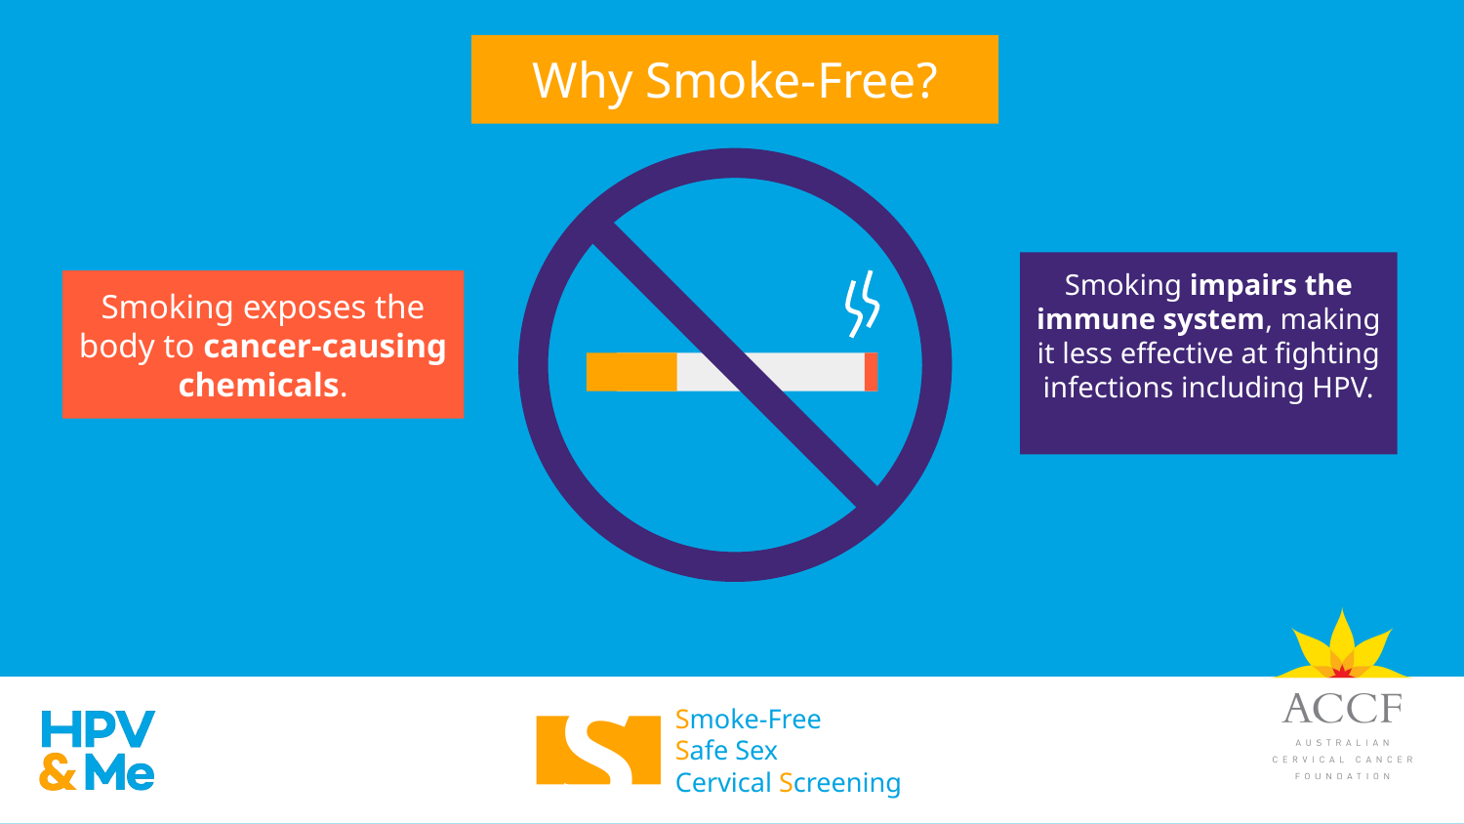
So smoking increases cancer risk and weakens immune defense.
Notes:
[Sources]
- Background image derived from the user-provided ACCF PowerPoint deck uploaded in this conversation.

Slide 24
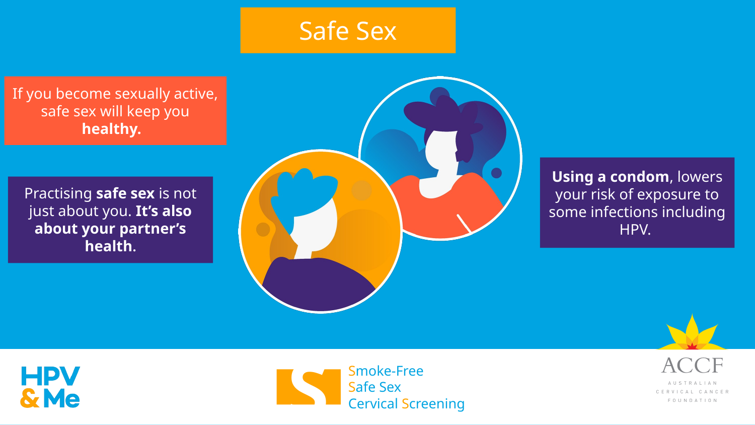
If you become sexually active, practising safe sex will keep you healthier.
Notes:
[Sources]
- Background image derived from the user-provided ACCF PowerPoint deck uploaded in this conversation.

Slide 25
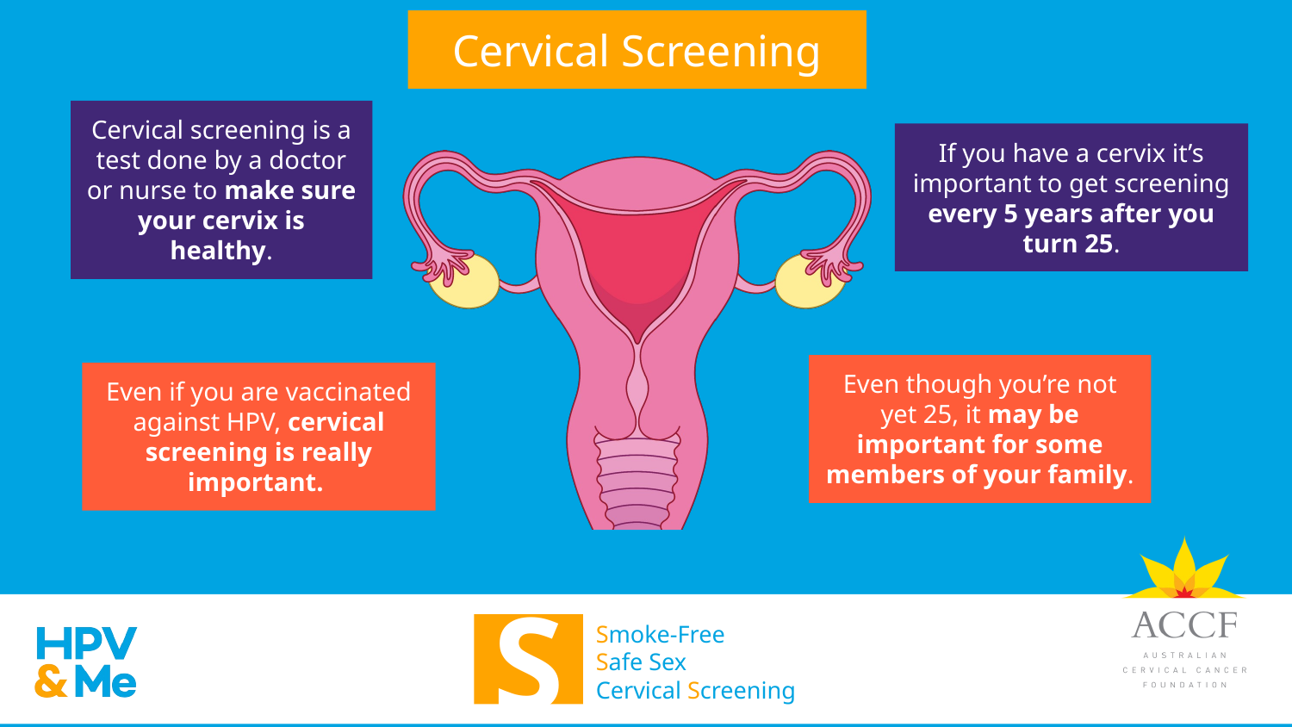
Notes:
[Sources]
- Background image derived from the user-provided ACCF PowerPoint deck uploaded in this conversation.

Slide 26
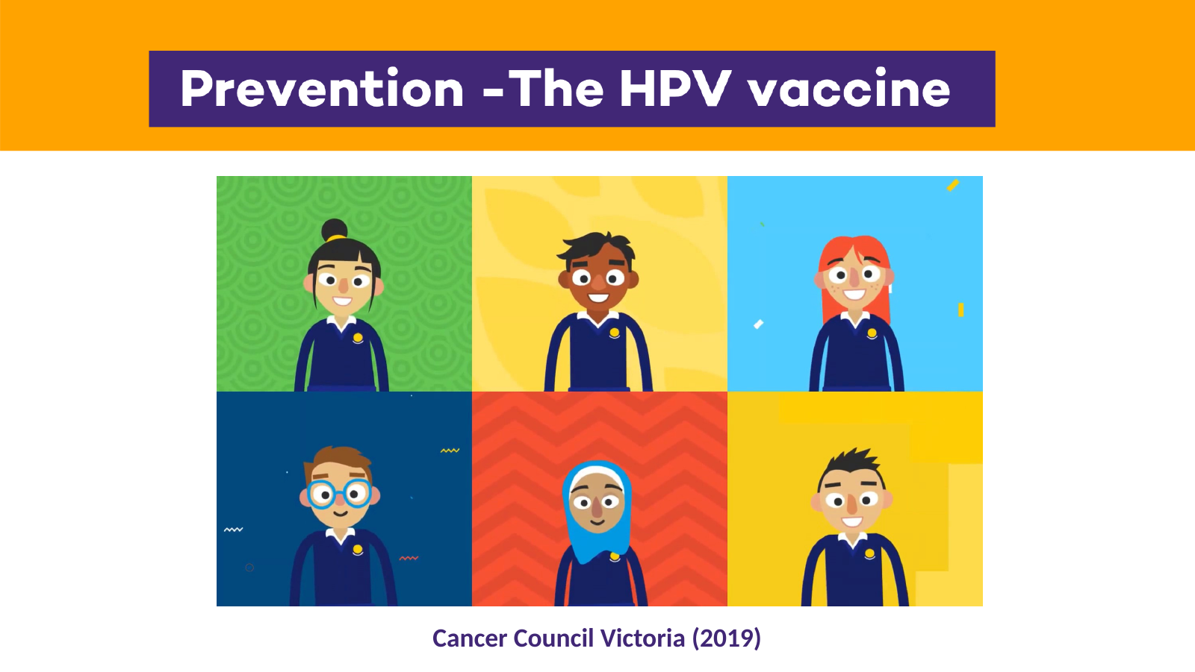
Click on ‘HPV vaccination for teenagers’ in the following link:
HPV vaccine resources - HPV Vaccine - Cancer Council
Notes:
[Sources]
- Background image derived from the user-provided ACCF PowerPoint deck uploaded in this conversation.

Slide 27
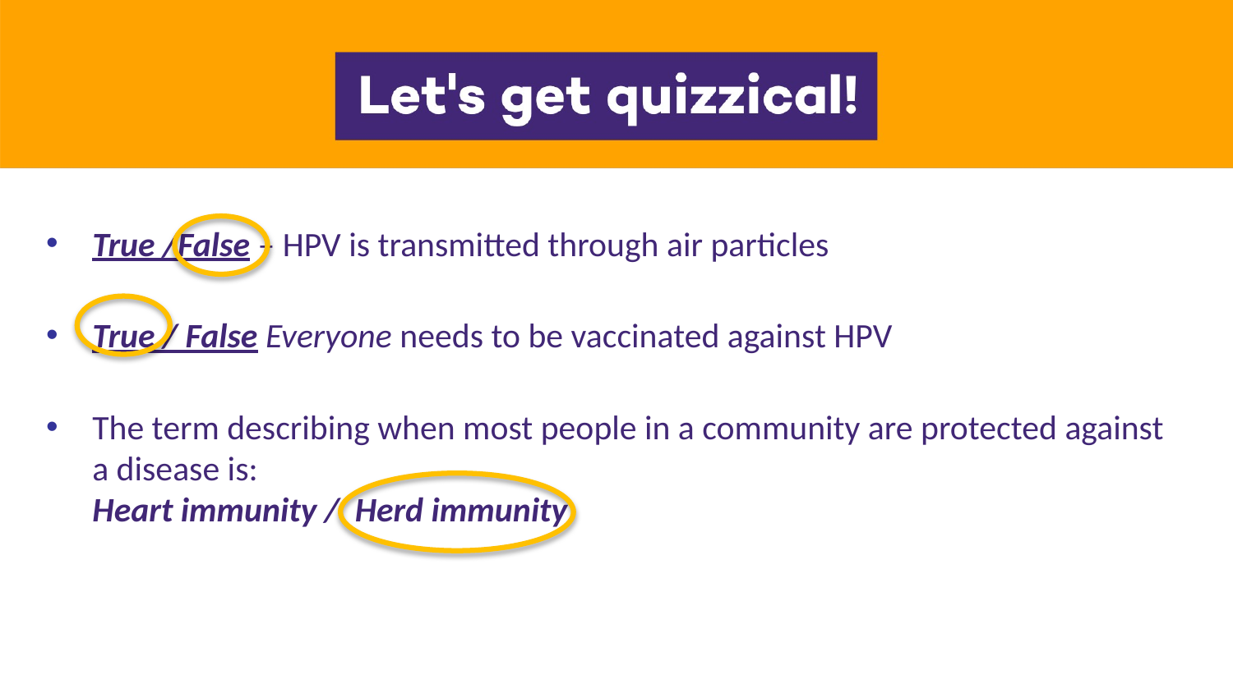
1) HPV is transmitted through air particles.
True
False
2) Everyone needs to be vaccinated against HPV.
True
False
3) When most people in a community are protected, this is called…
Heart immunity
Herd immunity
Click an answer to reveal the correct responses.
Notes:
[Sources]
- Background image derived from the user-provided ACCF PowerPoint deck uploaded in this conversation.

Slide 28
Here’s the answers…
Notes:
[Sources]
- Background image derived from the user-provided ACCF PowerPoint deck uploaded in this conversation.

Slide 29
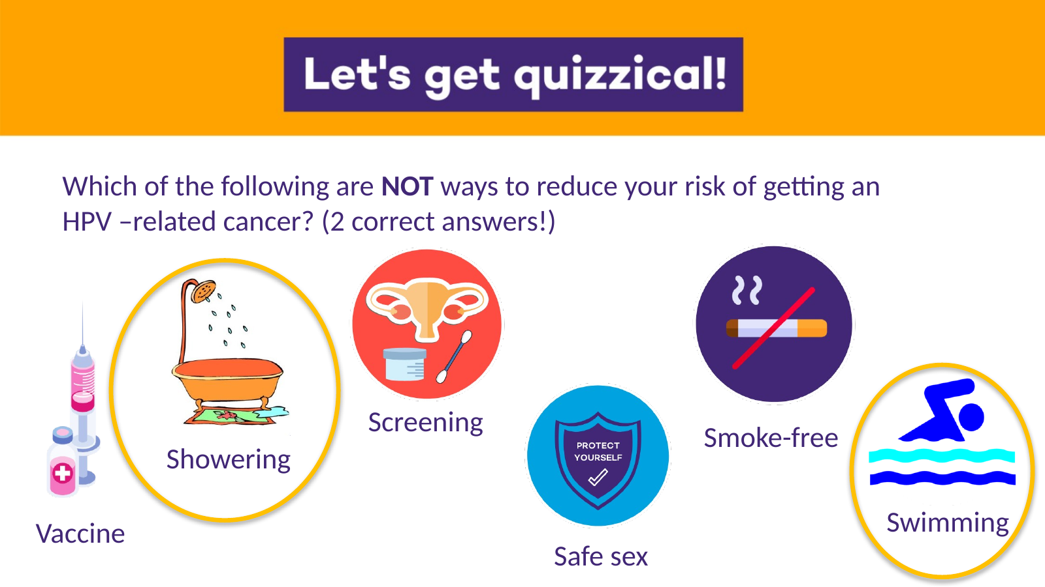
Which 2 below are NOT ways to reduce the risk of HPV-related cancer?
Vaccination
Showering
Screening
Safe sex
Smoke-free
Swimming
Click on an answer when you’re ready to reveal the two correct choices.
Notes:
[Sources]
- Background image derived from the user-provided ACCF PowerPoint deck uploaded in this conversation.

Slide 30

Showering and swimming – these do not reduce your risk of getting HPV
Notes:
[Sources]
- Background image derived from the user-provided ACCF PowerPoint deck uploaded in this conversation.

Slide 31
Team challenge
Work with a partner or small group. Choose one question and be ready to share your best answer.
What are the 3 most important points people need to know about HPV?
How can you convince someone that the HPV vaccine is important?
How does vaccination help to develop herd immunity?
What are the 3 most important points you have learnt today to tell your parents?
There is not just one perfect answer — focus on the key ideas.
Continue
Notes:
[Sources]
- Discussion prompts derived from the user-provided hidden discussion slide in the uploaded ACCF deck.

Slide 32

Lets watch a video on what happens on vaccination day.
Getting your human papillomavirus (HPV) vaccination at school — what to expect - YouTube
Notes:
[Sources]
- Background image derived from the user-provided ACCF PowerPoint deck uploaded in this conversation.

Slide 33
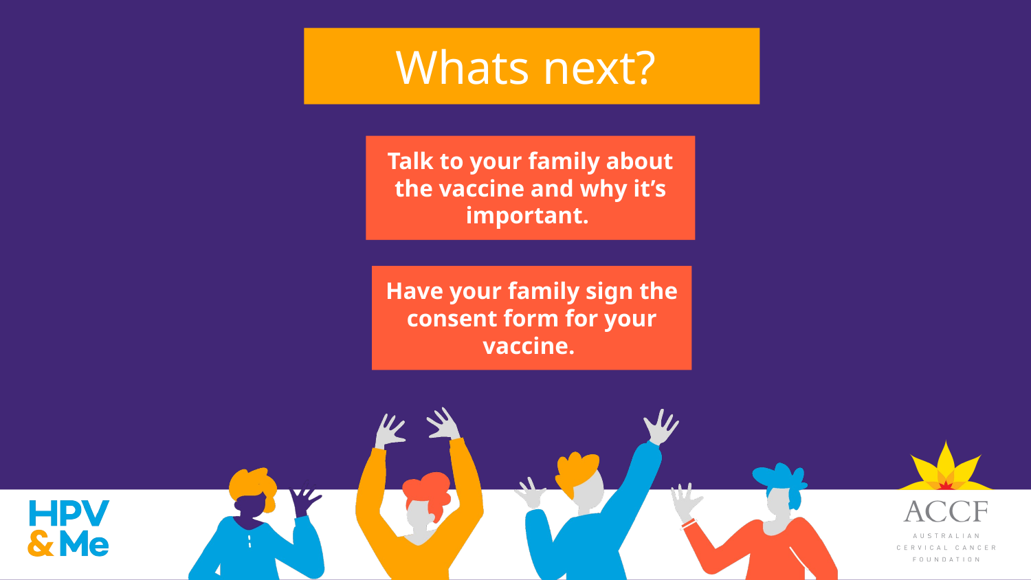
Notes:
[Sources]
- Background image derived from the user-provided ACCF PowerPoint deck uploaded in this conversation.

Slide 34

Notes:
[Sources]
- Background image derived from the user-provided ACCF PowerPoint deck uploaded in this conversation.

Slide 35


Thank you for your time.
If you’d like to find out more about HPV, cervical cancer, the HPV vaccination, and what we do at the Australian Cervical Cancer Foundation, scan here for more information.
Thank you for your time – help us prevent cervical cancer for a healthier Australia and healthier neighbouring countries.
Notes:
[Sources]
- Background image derived from the user-provided ACCF PowerPoint deck uploaded in this conversation.

Slide 36

The Australian Cervical Cancer Foundation is a charity helping prevent cervical cancer here and overseas.
If you’d like to help us with a donation, please scan here – thank you!
Thank you for your time – help us prevent cervical cancer for a healthier Australia and healthier neighbouring countries.
Notes:
[Sources]
- Background image derived from the user-provided ACCF PowerPoint deck uploaded in this conversation.

Slide 37


Notes:
[Sources]
- Background image derived from the user-provided ACCF PowerPoint deck uploaded in this conversation.

